Slide 1
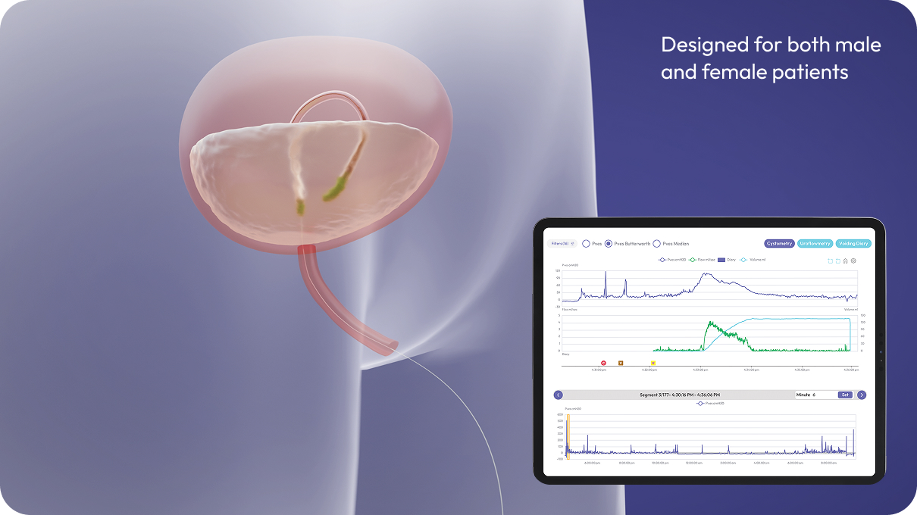
Glean Bladder Diagnostics
Referring Physician Update
The Glean® Urodynamics System is the first and only wireless, catheter-free urodynamics system — It captures physiologic bladder and voiding data while patients move through their day — real symptoms, real data— something conventional urodynamics has never been able to offer.
How Glean Works
A small, wireless sensor is placed through the urethra into the bladder. It collects physiologic bladder data that's later analyzed to clearly diagnose whether symptoms originate from the bladder, sphincter, or urethra.
Who to Refer
If patients aren't responding to first-line medication and have:
Urinary urgency and frequency
Urinary incontinence (stress, urge, or mixed)
Hesitancy, weak stream, or straining to void
Incomplete bladder emptying or urinary retention
Any other LUTS symptom not resolved with medical management
Your Patient Stays Your Patient
After the Glean evaluation, we'll send a full report of findings and recommendations back to your office — your patient returns to your care with clear, physiologic data to guide next steps.
To refer a patient:
[Physician Name], [Credentials]
[Practice Name]
Phone: [Phone Number] | Fax: [Fax Number]
[Email Address] | [Practice Address]
[Website address]
Replace with Logo
To learn more: www.gleanuds.com

